Slide 1
Exception Handling
Types of error
There are three types of error: syntax errors, logical errors and run-time errors. (Logical errors are also called semantic errors).
Exception Handling is the mechanism to handle runtime malfunctions. We need to handle such exceptions to prevent abrupt termination of program. The term exception means exceptional condition, it is a problem that may arise during the execution of program. A bunch of things can lead to exceptions, including programmer error, hardware failures, files that need to be opened cannot be found, resource exhaustion etc.
“Exceptions are errors that occur at runtime and disrupt the normal flow of execution of instructions in a program”
“”
Notes:
1

Slide 2
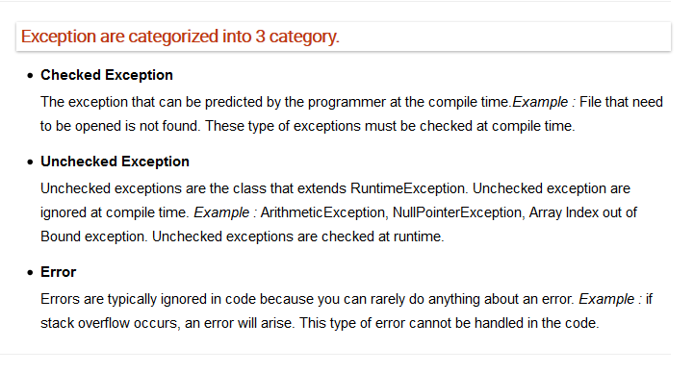

Slide 3
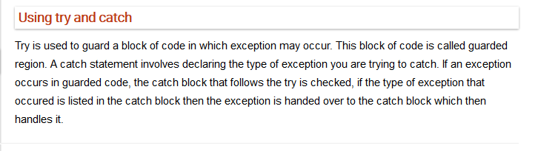
C# exception handling is built upon four keywords: try, catch, finally, and throw.
try: A try block identifies a block of code for which particular exceptions is activated. It is followed by one or more catch blocks.
catch: A program catches an exception with an exception handler at the place in a program where you want to handle the problem. The catch keyword indicates the catching of an exception.
finally: The finally block is used to execute a given set of statements, whether an exception is thrown or not thrown. For example, if you open a file, it must be closed whether an exception is raised or not.
throw: A program throws an exception when a problem shows up. This is done using a throw keyword.

Slide 4
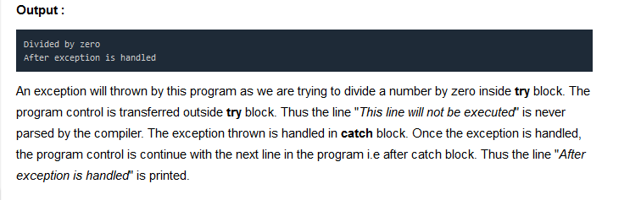
class Excp { public static void Main(String args[]) { int a,b,c; try { a=0; b=10; c=b/a; Console.writeline("This line will not be executed"); } catch(ArithmeticException e) { Console.writeline (“Divided by zero"); } Console.writeline("After exception is handled"); } }

Slide 5
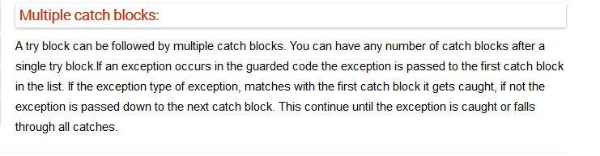
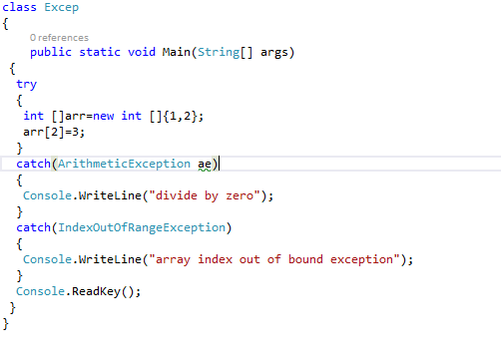

Slide 6
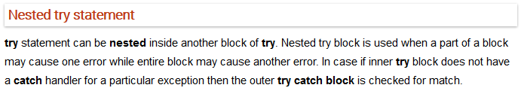
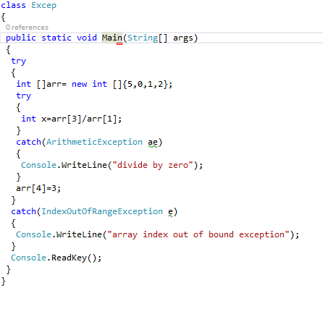


Slide 7
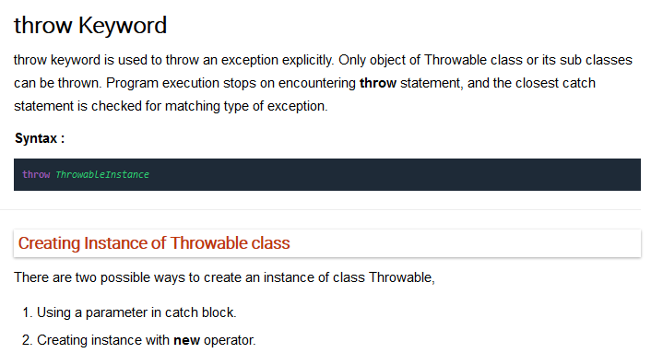

Slide 8
class Test
{
static void avg()
{
try
{
throw new ArithmeticException("demo");
}
catch(ArithmeticException e)
{
Console.WriteLine("Exception caught");
}
}
public static void Main(String []args)
{
avg();
Console.ReadKey();
}
}

Slide 9
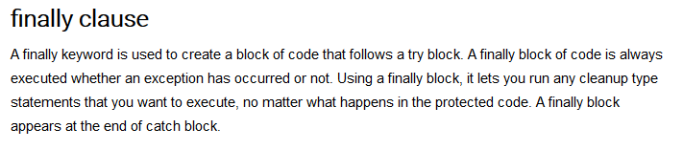
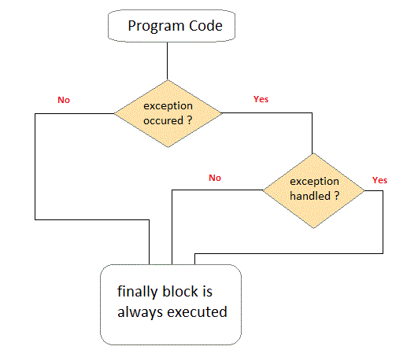

Slide 10
